Slide 1

Data
Umair Mehmood Imam

Slide 2
Steps to design an A.I system
Identify the problem
Prepare the data
Choose the algorithms
Train the algorithms with the data
Run on a selected platform

Slide 3
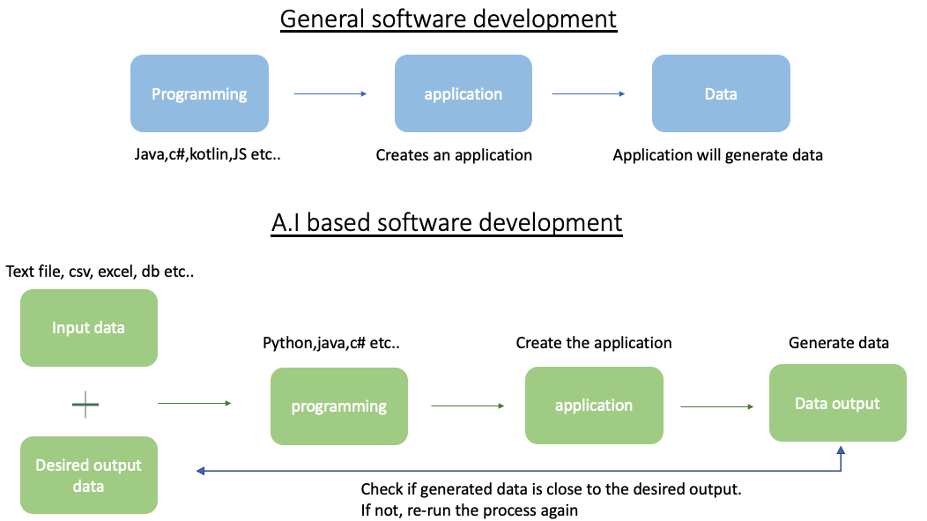

Slide 4
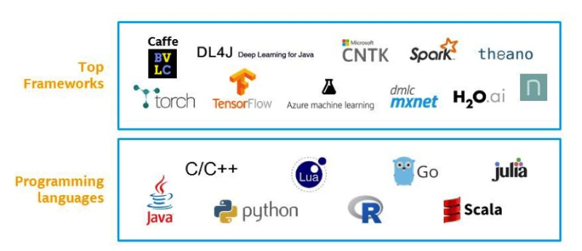
A.I is about algorithms, tools and data
Algorithms and tools
DATA
Open data sets. e.g Kaggle
Private data, e.g. any organizations data

Slide 5
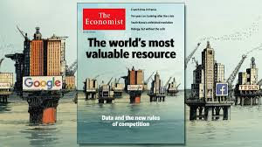
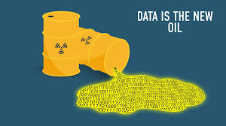
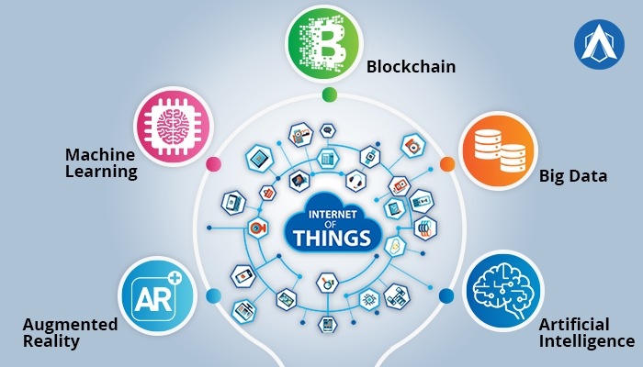

Slide 6

Daily life of an A.I programmer
80% time spend on data (cleaning, preparing, labeling, analyzing etc)
5% on deployment (cloud/on premise)
15% on A.I development
Notes:
This means there is a huge demand for data engineers.
Organizations are not looking for A.I engineers. They are looking for data engineers/ software engineers who can also work with A.I

Slide 7
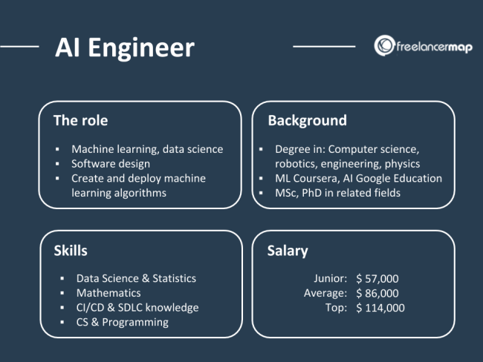

Slide 8
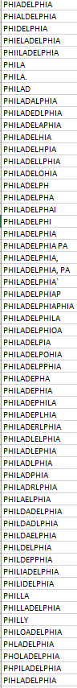
Data pitfalls (problems which can occur with data)
Assuming the data is clean
e.g spelling mistakes
Outliers
Excluding outliers
Including outliers
Ignroing seasonality
Easter vacations, summer holidays, black Friday etc.
Context is critical
Ignoring size when reporting growth
Notes:
Ref: https://medium.com/@mrogati/data-pitfalls-the-startup-edition-fe1eebcc39da
Outliers: In statistics, an outlier is a data point that differs significantly from other observations.
Excluding outliers: Those 21 people using your product more than a thousand times a day? Either they’re your biggest fans, or bots crawling your site for content. Whichever they are, ignoring them would be a mistake.
Including Outliers: While those 21 people using your product a thousand times a day are interesting from a qualitative perspective, because they can show you things you didn’t expect, they can be problematic when building models. You probably want to exclude them when building data products; otherwise, the ‘…you may also like…” feature on your site will have the same items everywhere.
Ignroing seasonality: Easter vacations, summer holidays, black Friday etc.
At Ruter we cannot assume that the passenger capacity will be the same on special seasonal days.
Context is critical: Context is critical. When you’ve just started, technically, your dad signing up just doubled your user base.

Slide 9
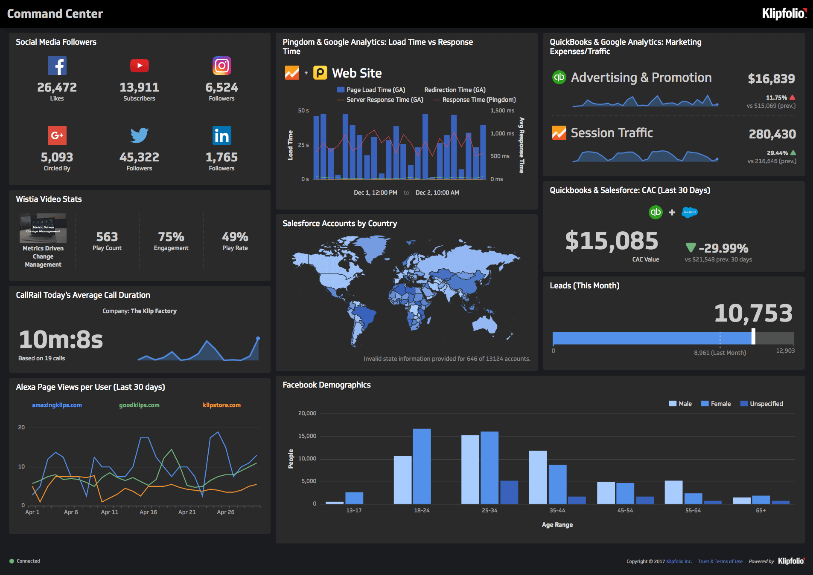
Countinued..
Poor data Insights
Not connecting with external data
Lacking business understanding
Notes:
Data Insights: we need eyes into our data. Popular way to get these insights is to create dashboards or reports
External data: It helps to combine your data with external data, like social media data, weather data etc..
Business understanding: its critical to know the business before working with the data. Not knowing the reason or the intention why the data was produced in the first place can mess up its desired outpout

Slide 10
How to work with data ?
Data labeling / annotation
Data annonimization
Synthetic data
Data preperation
Data cleansing + feature engineering
Data wrangling
Data mining
Data warehousing
ETL programming
Data Engineering
Infrastructure, big data, cloud etc..

Slide 11
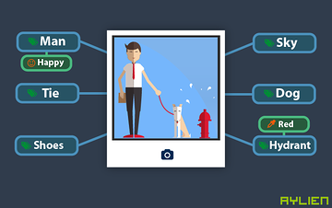
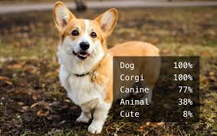
1. Data Labeling / annotation

Slide 12
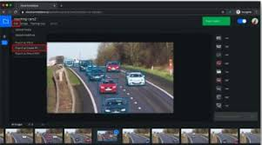
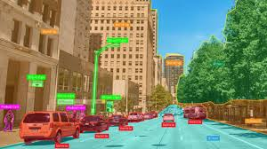

Slide 13
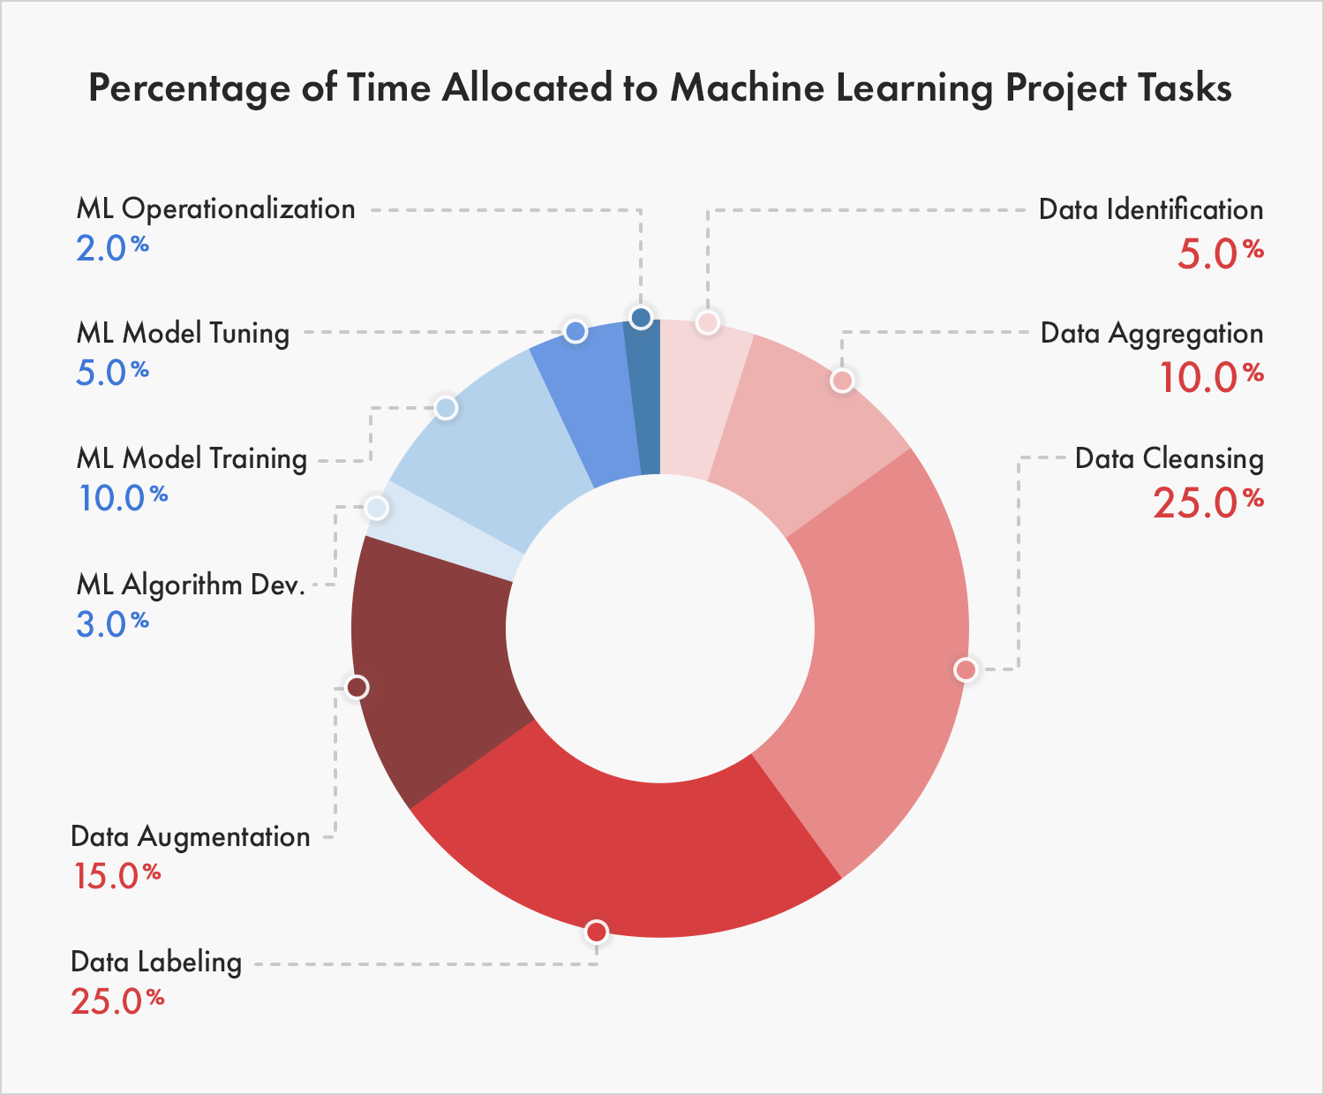
Notes:
Ref: https://www.cloudfactory.com/data-labeling-guide

Slide 14

Notes:
Lidar (/ˈlaɪdɑːr/, also LIDAR, LiDAR, and LADAR) is a method for measuring distances (ranging) by illuminating the target with laser light and measuring the reflection with a sensor. Differences in laser return times and wavelengths can then be used to make digital 3-D representations of the target. It has terrestrial, airborne, and mobile applications.

Slide 15


2. Data annonimization

Slide 16
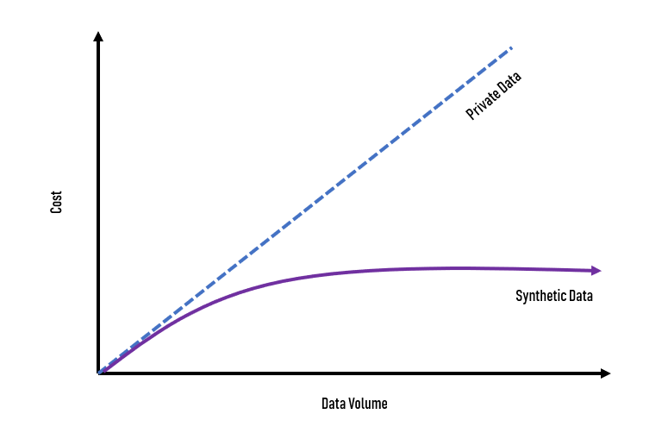
3. Synthetic data

Slide 17
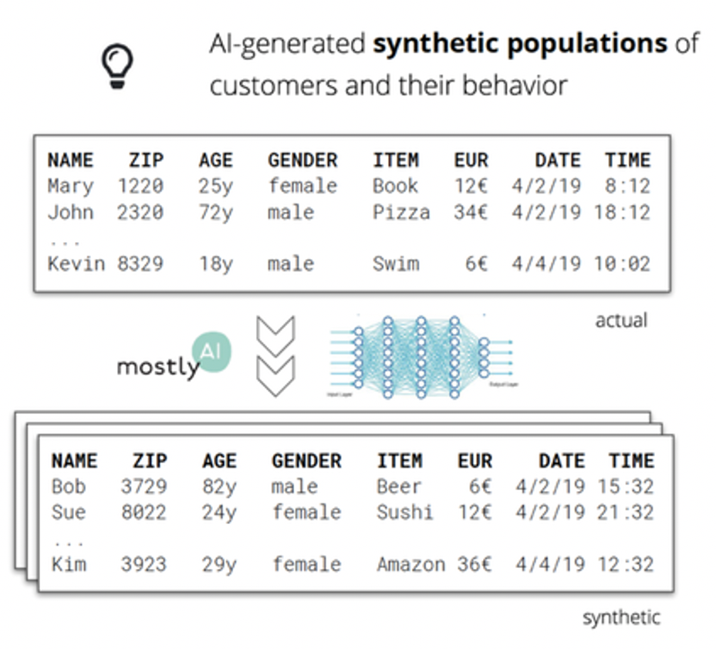
Notes:
Ref: Mostly AI

Slide 18
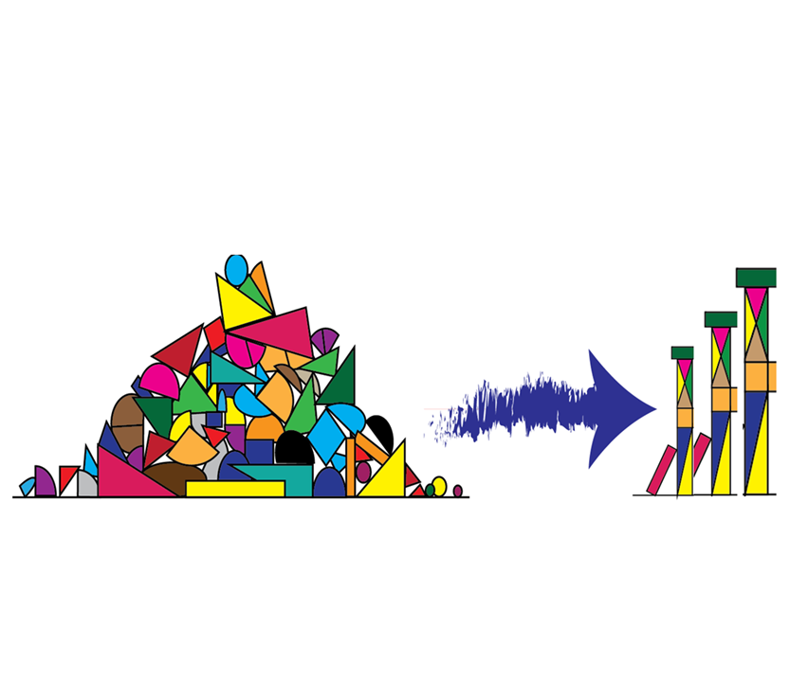
4. Data preperation(cleansing + feature engineering)
Feature engineering, also known as feature creation, is the process of constructing new features from existing data to train a machine learning model.
Notes:
Feature:
In machine learning and pattern recognition, a feature is an individual measurable property or characteristic of a phenomenon being observed.
Feature engineering:
Feature engineering is the process of using domain knowledge to extract features from raw data via data mining techniques. These features can be used to improve the performance of machine learning algorithms. Feature engineering can be considered as applied machine learning itself ^{[1]}.

Slide 19
For example
Character recognition
features may include histograms counting the number of black pixels along horizontal and vertical directions, number of internal holes, stroke detection and many others.
Speech recognition
features for recognizing phonemes can include noise ratios, length of sounds, relative power, filter matches and many others.
Spam detection
features may include the presence or absence of certain email headers, the email structure, the language, the frequency of specific terms, the grammatical correctness of the text.
Computer vision
there are a large number of possible features, such as edges and objects.

Slide 20
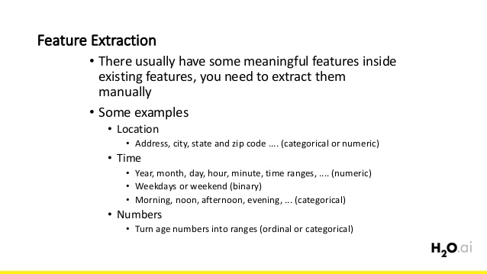

Slide 21

Notes:
Extract features from this image

Slide 22
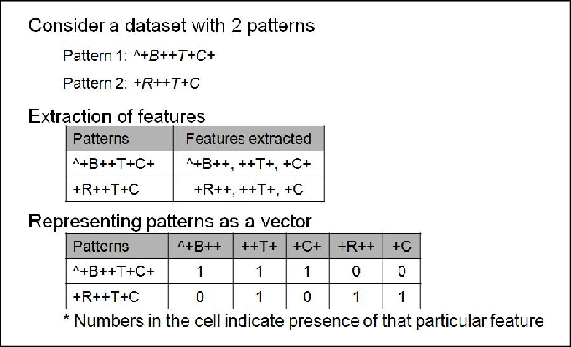
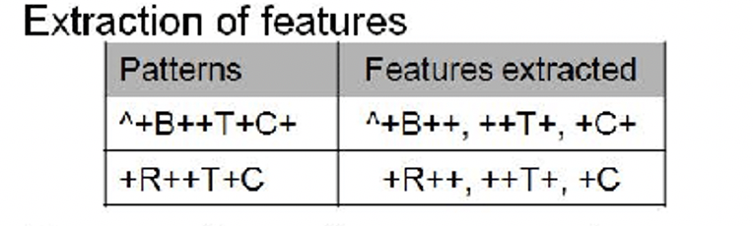
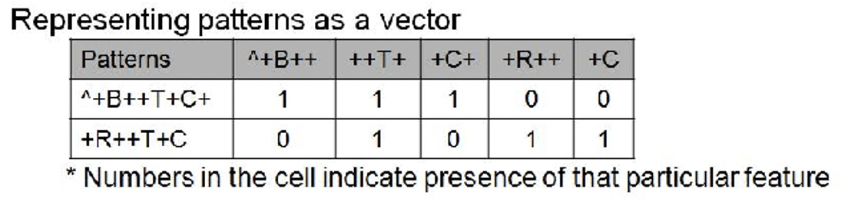
Notes:
Ref: https://www.researchgate.net/figure/2-Example-of-feature-extraction_fig2_252019579

Slide 23
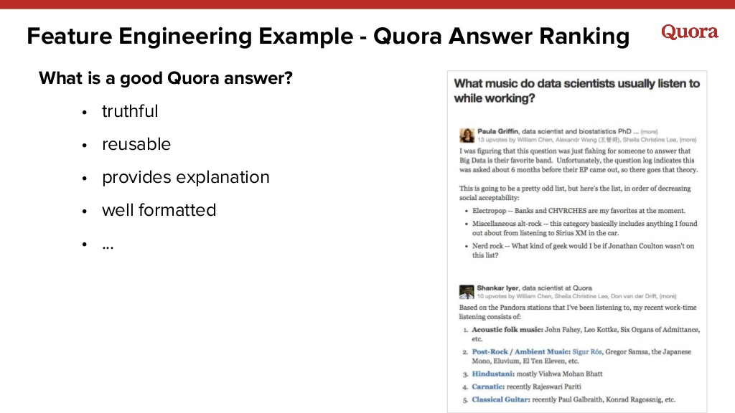
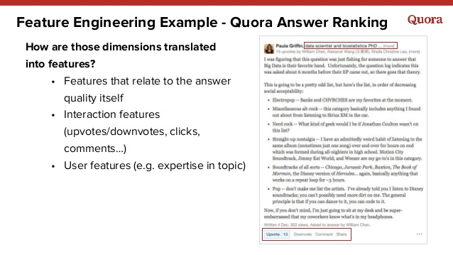

Slide 24
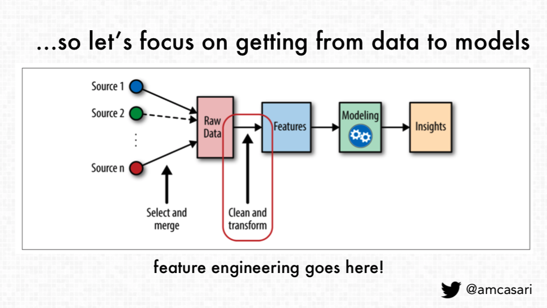
Data preperation(cleansing + feature engineering)

Slide 25
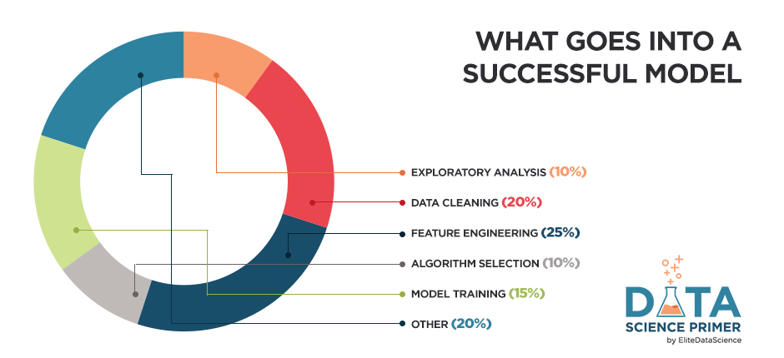

Slide 26
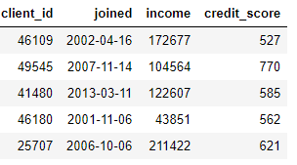
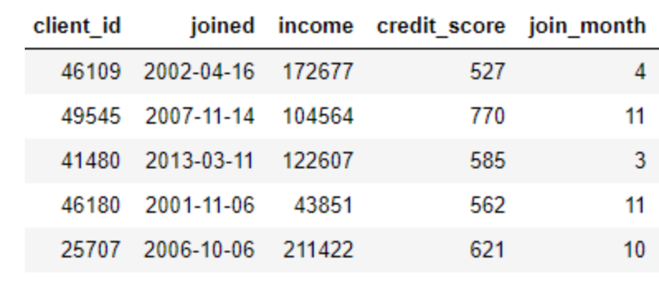
Feature engineering -> Transformations
Transformations
Create new features out of one or more of the existing data.
Notes:
Feature engineering requires extracting the relevant information from the data and getting it into a single table which can then be used to train a machine learning model.
We can group the operations of feature creation into two categories: transformations and aggregations.
Rf: https://towardsdatascience.com/automated-feature-engineering-in-python-99baf11cc219

Slide 27
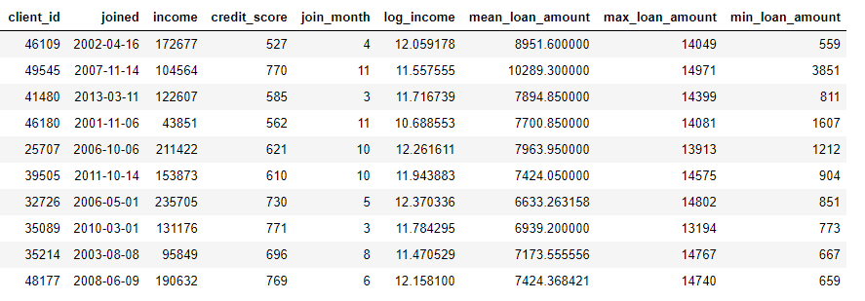
Feature engineering -> Aggregations
Aggregations
Performed across data and usually calculates statistics
Notes:
Feature engineering requires extracting the relevant information from the data and getting it into a single table which can then be used to train a machine learning model.
We can group the operations of feature creation into two categories: transformations and aggregations.
Rf: https://towardsdatascience.com/automated-feature-engineering-in-python-99baf11cc219

Slide 28
Please read on your own time
https://towardsdatascience.com/feature-engineering-in-python-part-i-the-most-powerful-way-of-dealing-with-data-8e2447e7c69e

Slide 29
5. Data wrangling
The process of transforming and mapping data from one "raw" data form into another format with the intent of making it more appropriate and valuable for a variety of downstream purposes such as analytics.
Tools:
Python, Excel, Tablua, Google data prep

Slide 30
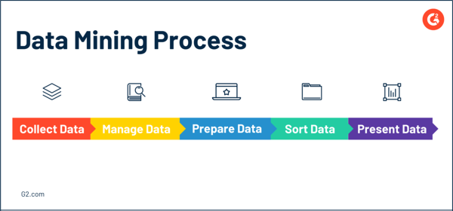
6. Data Mining
The process of discovering patterns in large data sets involving methods at the intersection of machine learning, statistics, and database systems.
Notes:
For example, through data mining, a business may be able to see which customers are buying specific products at certain times of the year. This information can then be used to segment those customers. Customer segmentation is important for targeting sales and marketing campaigns – which may lead to higher profits, but also point toward a potential trend or two.
In addition to automated decision-making, data mining is also an important tool because it can accurately predict and forecast trends for your business based on historical information and current conditions. It also has the capability to allow for more efficient use and allocation of resources so that businesses can plan and make automated decisions to maximize cost reduction.
Ref: https://learn.g2.com/data-mining

Slide 31
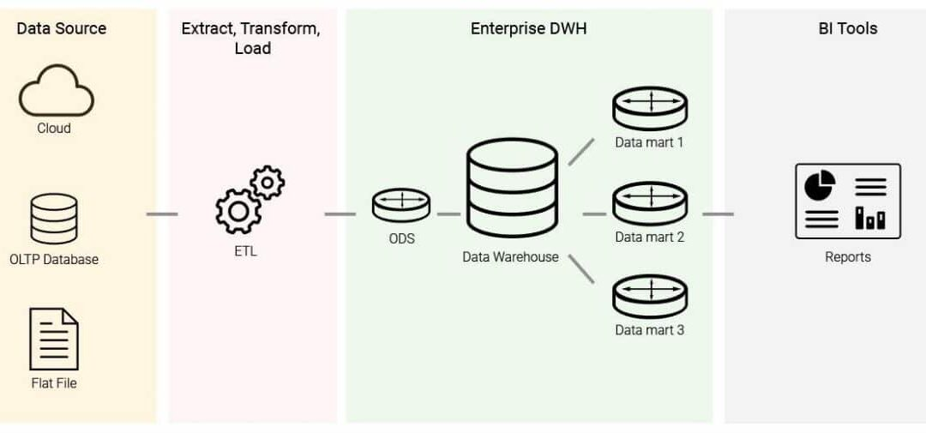
7. Data warehousing

Slide 32
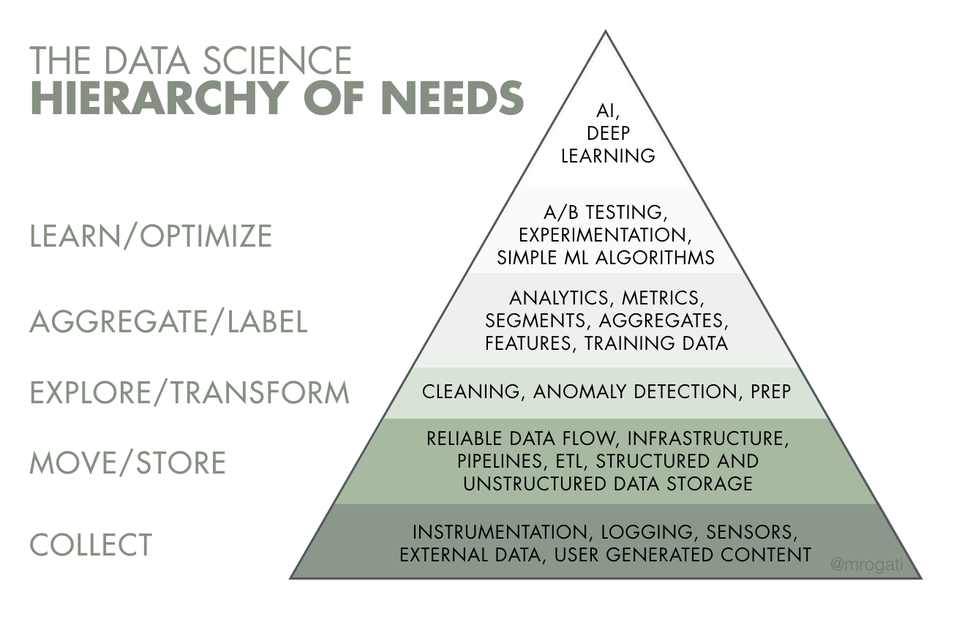
by Monica Rogati
Notes:
By Monica Rogati
Ref: https://medium.com/hackernoon/the-ai-hierarchy-of-needs-18f111fcc007

Slide 33
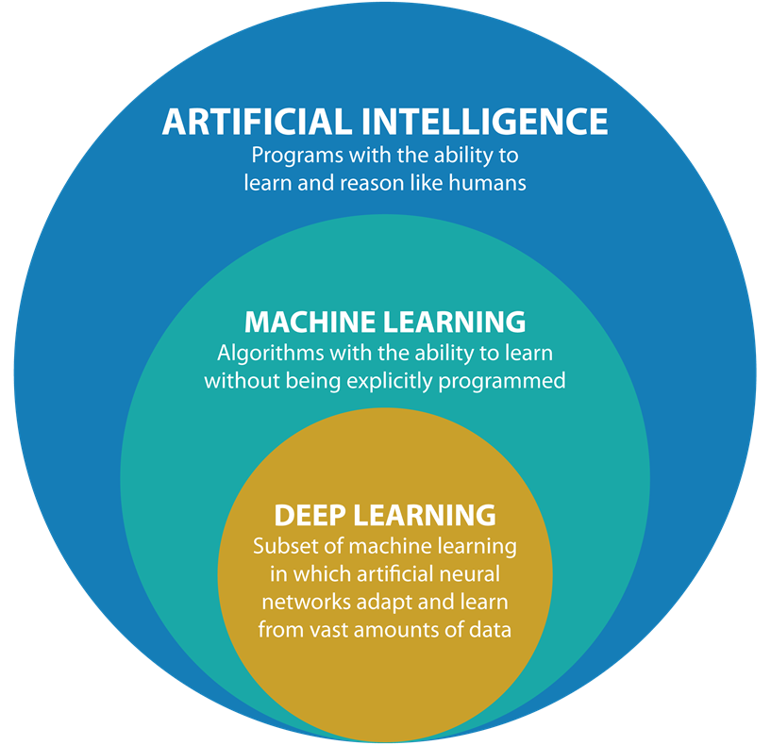
This has given rise to a field related to AI,
DATA SCIENCE

Slide 34
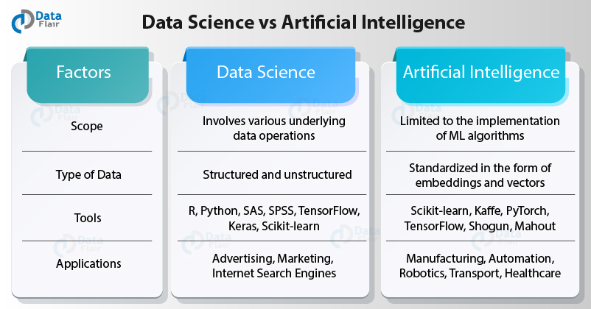
Notes:
Ref: https://data-flair.training/blogs/data-science-vs-artificial-intelligence/

